Slide 1

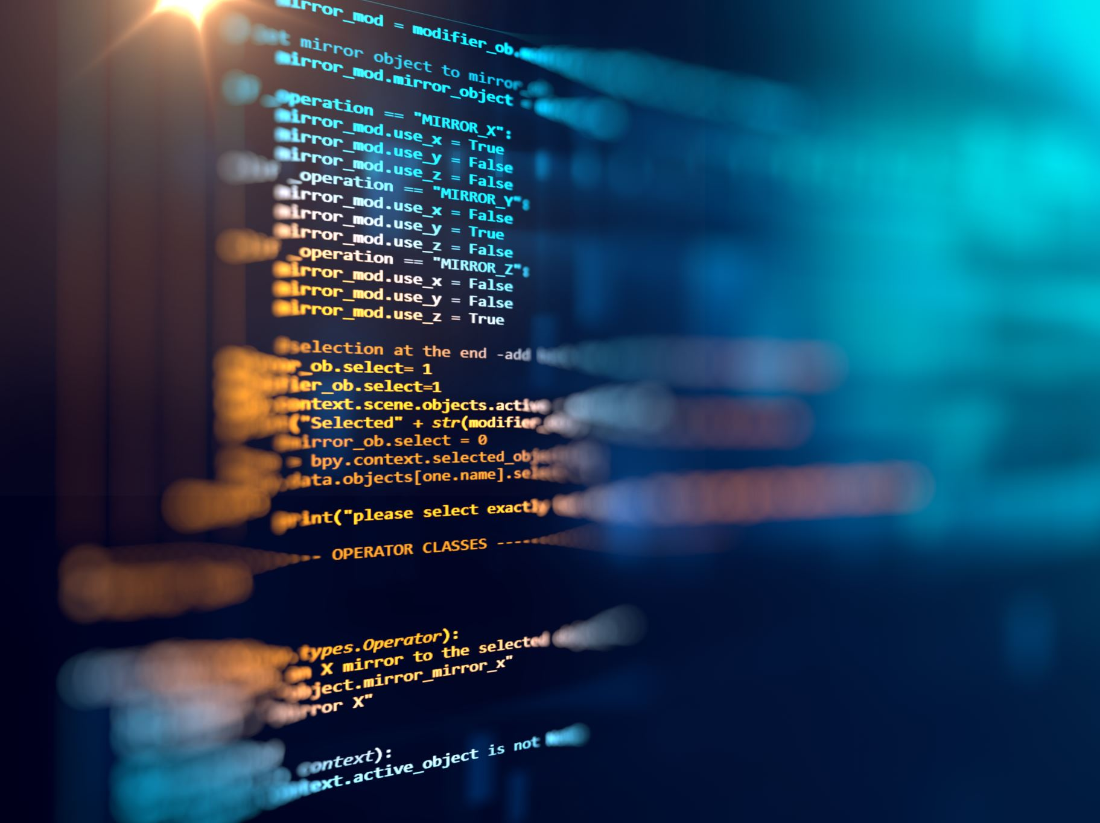
TCS3254
PROGRAMMING FOR
MOBILE DEVICES
TCS3254
PROGRAMMING FOR
MOBILE DEVICES
web and mobile
DEVELOPMENT
introduction to flutter and WIDGETS
Building Layout using Widgets
Application Environment and Framework
1
1

Slide 2
What is Flutter?
Flutter is Google's UI toolkit for building beautiful, natively compiled applications from a single codebase
Features:
  hot reload function - quickly and easily experiment, build UIs, add features, and fix bugs faster.
  built-in Material Design and Cupertino widgets, rich motion APIs, smooth natural scrolling, etc.
  widgets - incorporate platform differences e.g. scrolling, navigation, icons and fonts to provide full native performance on both iOS and Android.

Slide 3
the Widgets
Flutter widgets are a core part of the framework - "Everything is a widget" .
Widgets can be understood as the visual representation of parts of the application. Many widgets are put together to compose the UI of an application.
The intention of widgets is to provide a way for your application to be modular, scalable, and expressive with less code and without imposing limitations.

Slide 4
The Widgets
The widgets also are components used to create user interface of the application.
The application itself is a widget – i.e. the topmost widget and its UI is build using one or more children (widgets), which again build using its children widgets.
This composability feature helps to create a user interface of any complexity.

Slide 5
The Widgets
The View of the screen totally depends on the sequence and choice of the widgets way to declare and construct the UI.
It is more than just structural elements. The widgets includes Text widget, Row & Column widget, Container widget, Stack widget, Padding widget, Center widget, and many more.
It’s helpful to display something, it might help to make design, handle user interaction and many more.

Slide 6
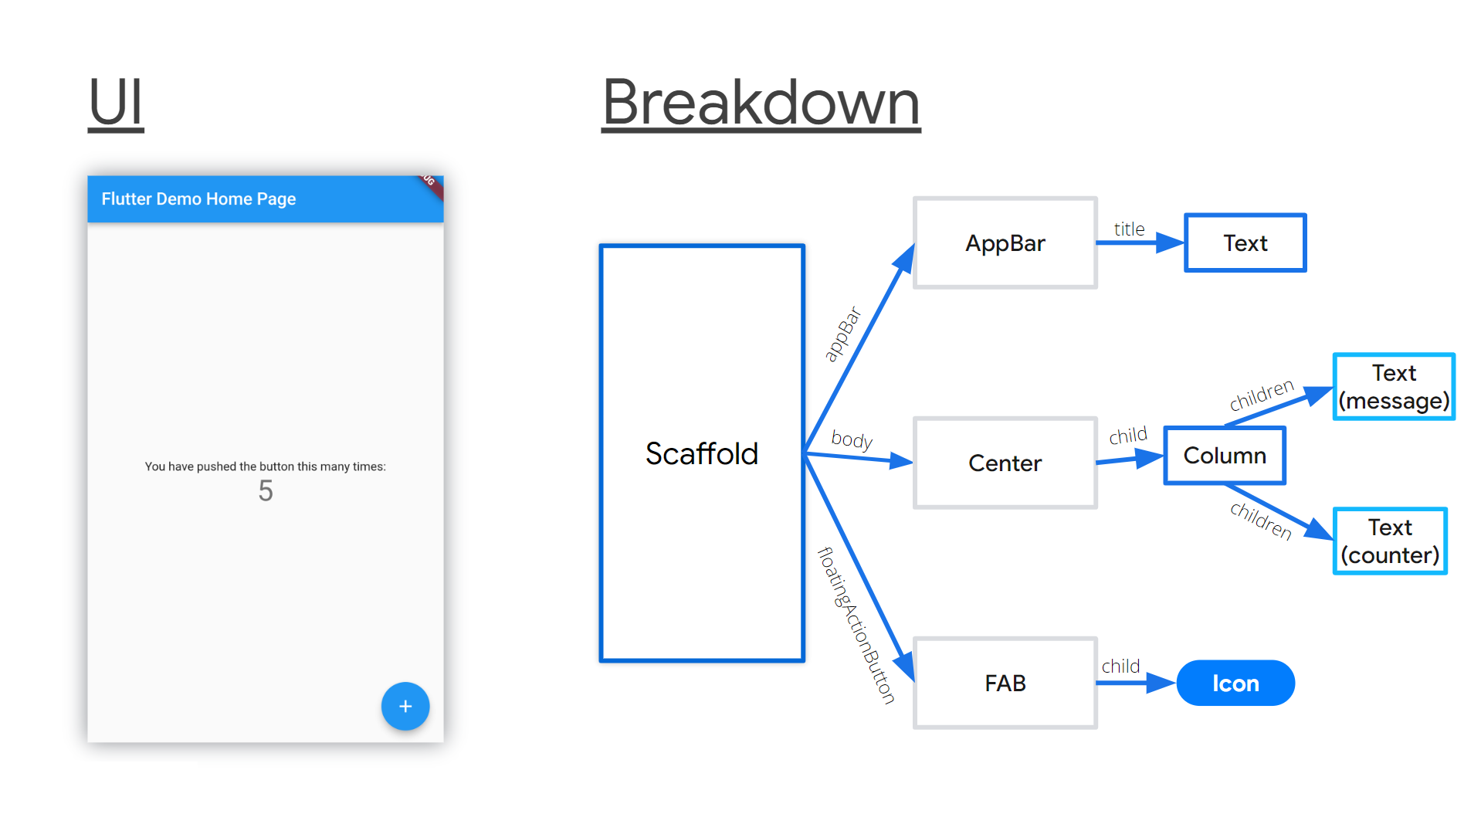

Slide 7
Material App vs Non-Material App
A Material App uses Google's Material Design principles.
It follows specific guidelines for the layout, components, and interaction patterns to create a consistent, modern, and intuitive user experience.
MaterialApp Widget wraps the entire application, providing easy access to Material Design features like theming, routing, and navigation.

Slide 8
Material App
class MyApp extends StatelessWidget {
const MyApp({super.key});
@override
Widget build(BuildContext context) {
return MaterialApp(
title: 'Flutter layout demo',
home: Scaffold(
appBar: AppBar(
title: const Text(‘Hello Flutter layout demo'),
),
body: const Center(
child: Text('Hello World'),
),
),
);
}
}
An application that uses Material Design
Example by Scaffold()

Slide 9
Material App vs Non-Material App
A Non-Material App does not rely on Material Design and can use a custom design system or another UI style.
These apps are often more customized or platform-specific using the Widget class without using Material components.
Developers can create their own layouts and UI elements.

Slide 10
Non-Material App
class MyApp extends StatelessWidget {
const MyApp({super.key});
@override
Widget build(BuildContext context) {
return Container(
decoration: const BoxDecoration(color: Colors.white),
child: const Center(
child: Text(
'Hello World',
textDirection: TextDirection.ltr,
style: TextStyle(
fontSize: 32,
color: Color.fromARGB(221, 48, 75, 186),
),
),
),
);
}
}

Slide 11
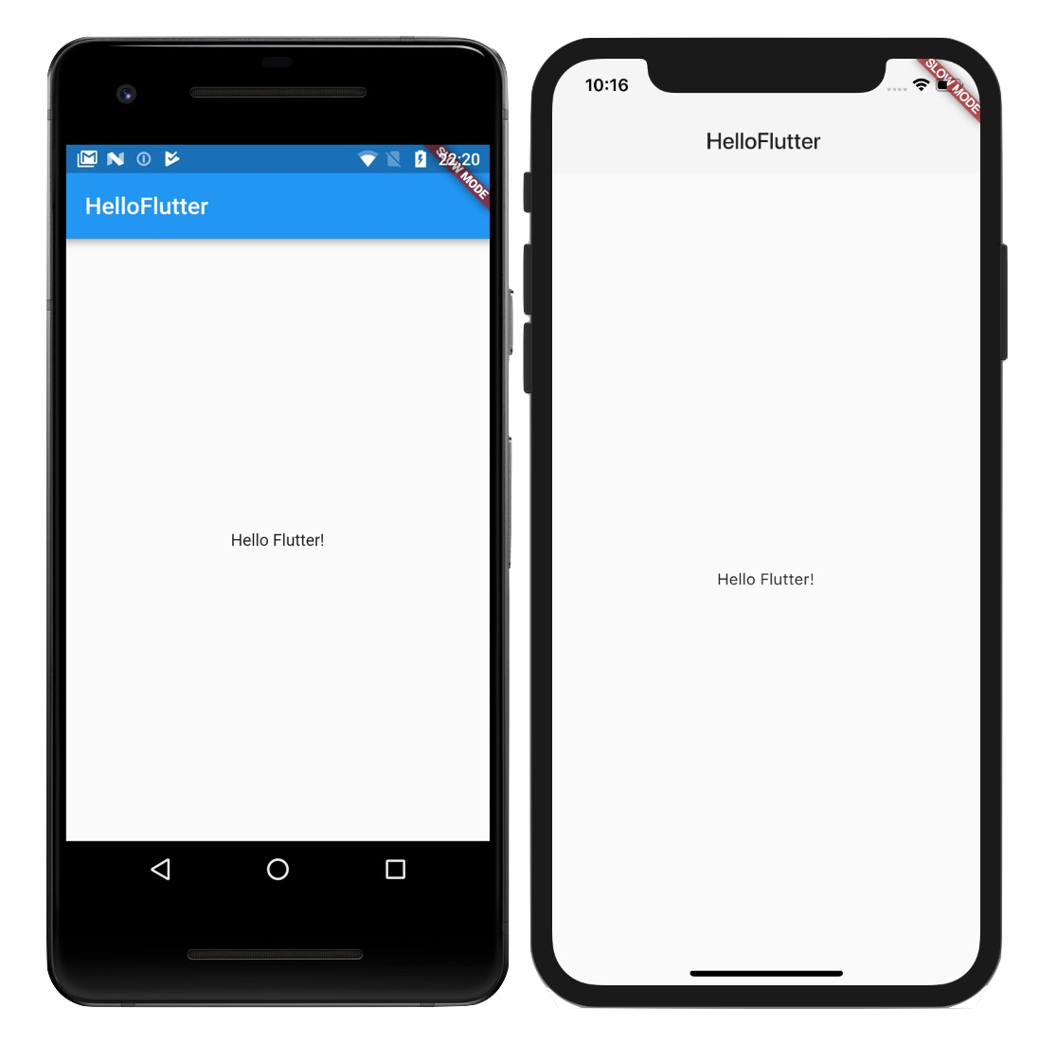

Slide 12
Scaffold Widget
In Flutter, a Scaffold is a fundamental layout structure used to create the basic visual framework for a Material Design app.
It provides components such as:
  AppBar: A top bar that typically displays the app’s title, actions, and navigation controls.
  Body: The main content area of the screen.
  Drawer: A sliding panel from the side of the screen.
  BottomNavigationBar: A navigation bar at the bottom of the screen that can switch between different sections of the app.
  FloatingActionButton: A circular button for a primary action in the app

Slide 13
Scaffold Widget
class MyApp extends StatelessWidget {
const MyApp({super.key});
@override
Widget build(BuildContext context) {
return MaterialApp(
title: 'Flutter layout demo',
home: Scaffold(
appBar: AppBar(
title: const Text(‘Hello Flutter layout demo'),
),
body: const Center(
child: Text('Hello World'),
),
), //end of scaffold
);
}
}

Slide 14
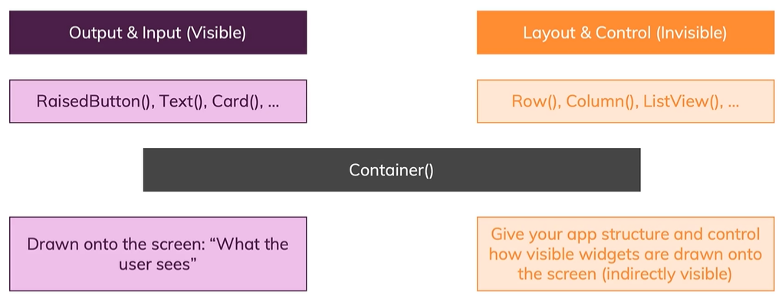
Different Type of Widgets
Flutter widgets are divided into two categories:
  Visible (Output and Input)
  Invisible (Layout and Control)

Slide 15
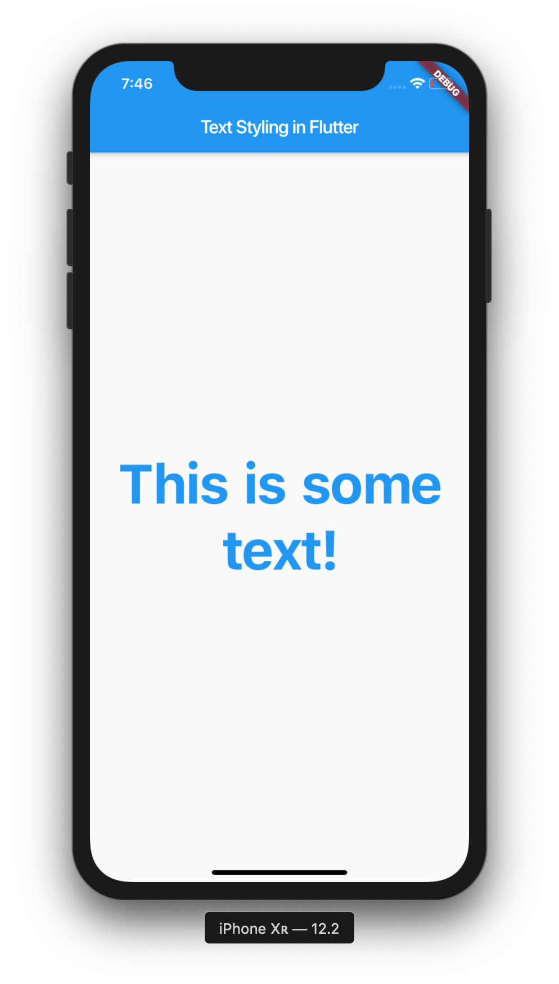
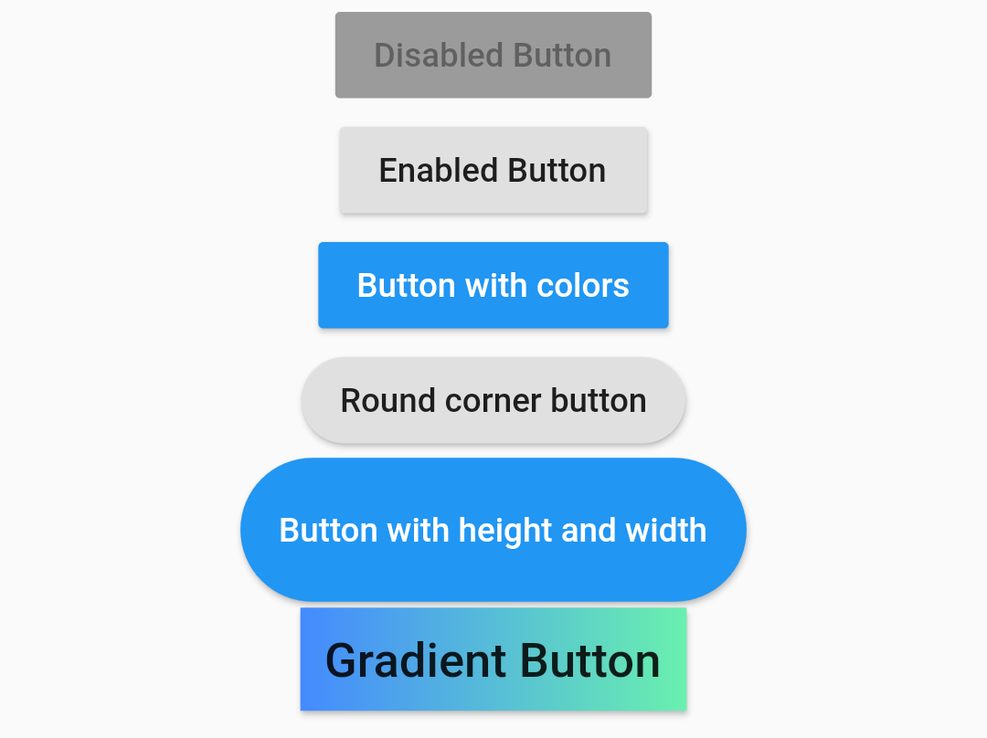
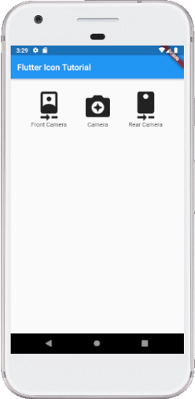
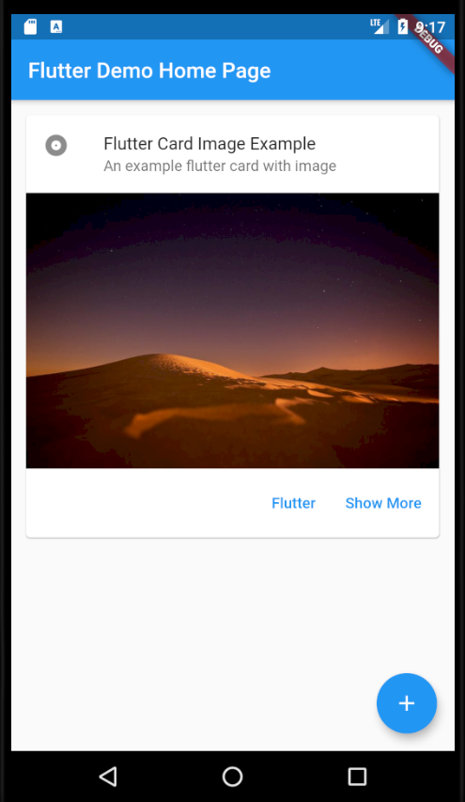
Different Type of Widgets –
Visible Widget
Text()
RaisedButton()
Icon()
Card()

Slide 16
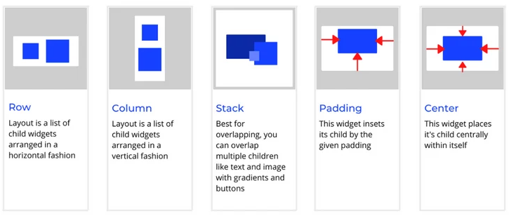
Different Type of Widgets –
Invisible Widget

Slide 17
The Visible Widgets
The visible widgets are related to the user input and output data.
Text('Hello World'),
Image.asset(
'images/cat.jpg',
fit: BoxFit.cover,
),
Icon(
Icons.star,
color:
Colors.red[500],
),

Slide 18
Text Widget
A Text widget holds some text to display on the screen.
This widget can give style property to allow the customization of Text, e.g.; font, font weight, font style, letter spacing, color, and many more.
To align the text widget, textAlign is used.

Slide 19
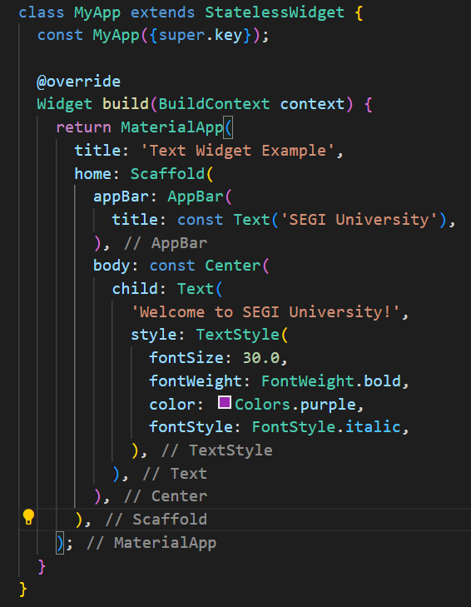

Text Widget

Slide 20
Text Widget
Key Properties of the Text Widget:
  data: The actual string that the Text widget displays.
  style: A TextStyle object that allows you to customize the appearance of the text (e.g., fontSize, fontFamily, color, etc.).
  textAlign: Controls how the text is aligned. It can be set to values like TextAlign.center, TextAlign.left, TextAlign.right, etc.
  maxLines: Limits the number of lines the text can occupy.
  overflow: Defines how to handle overflow
  softWrap: Controls whether the text should wrap to the next line if it exceeds the width. If set to false, the text won’t wrap.

Slide 21
Text Widget
TextStyle Properties:
  fontSize: Defines the size of the text.
  fontWeight: Sets the thickness of the text (e.g., FontWeight.bold, FontWeight.w500).
  color: Defines the colour of the text (e.g., Colors.blue).
  fontFamily: Allows to specify a custom font.
  letterSpacing: Sets the space between letters.
  wordSpacing: Sets the space between words.
  decoration: Adds underlining, strikethrough, or overlining (e.g., TextDecoration.underline).

Slide 22
Text Widget
Text(
'Welcome to Flutter!',
style: TextStyle(
fontSize: 20.0,
fontWeight: FontWeight.w500,
color: Colors.green,
letterSpacing: 2.0,
decoration: TextDecoration.underline,
),
textAlign: TextAlign.center,
);

Slide 23
Image Widget
Image widget is used to display images in the app's UI.
It allows app to load images from a variety of sources to add visual content to your application.
Types of Image Sources:
  Image.asset: Loads image from the project’s assets folder.
  Image.network: Loads image from the internet using a URL.
  Image.file: Loads an image from a local file.
  Image.memory: Loads an image from raw image data in memory (like a byte array).

Slide 24
IMAGE Widget
Image.asset(
'assets/images/flutter_logo.png',
width: 100,
height: 100,
);
Image.network( 'https://flutter.dev/assets/images/shared/brand/flutter/logo/flutter-lockup.png',
width: 100,
height: 100,
);

Slide 25
IMAGE Widget
Image.file(
File('/path/to/image.png'),
width: 100,
height: 100,
);
Image.memory(
Uint8List.fromList(myImageData),
width: 100,
height: 100,
);

Slide 26
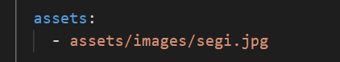
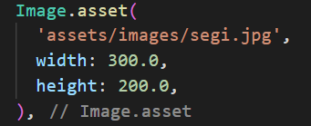
Image Widget
Assets Image widget uses an image from the root directory of project - add image path to pubspec.yaml file.
pubspec.yaml
main.dart

Slide 27
Image Widget
Key Properties of the Image Widget:
  width and height: Specify the dimensions of the image.
  fit: Determines how the image should fit within its bounding box. It can be:
    BoxFit.cover: The image covers the box
    BoxFit.contain: The image is resized to fit within the box
    BoxFit.fill: The image is stretched to fill the box
    BoxFit.fitWidth: Scales the image to fit the width.
    BoxFit.fitHeight: Scales the image to fit the height.
    BoxFit.none: No scaling, image is placed in its size.
    BoxFit.scaleDown: Similar to contain, but only scales down if necessary.

Slide 28
Image Widget
  color: Changes the color of the image using a color filter.
  alignment: Controls how the image aligns within its container, using values like Alignment.center, Alignment.topLeft, etc.
  repeat: Repeats the image if the box is larger than the image.
    ImageRepeat.repeat: Repeats both horizontally and vertically.
    ImageRepeat.repeatX: Repeats only horizontally.
    ImageRepeat.repeatY: Repeats only vertically.
  errorBuilder: Provides a way to handle errors when loading an image

Slide 29
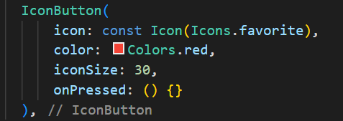
Icon Widgets
An icon is a graphic image representing an application or any specific entity.
Icons can be used as a representative symbol for a quick understanding of the functionality, or path of the navigation, etc.

Slide 30
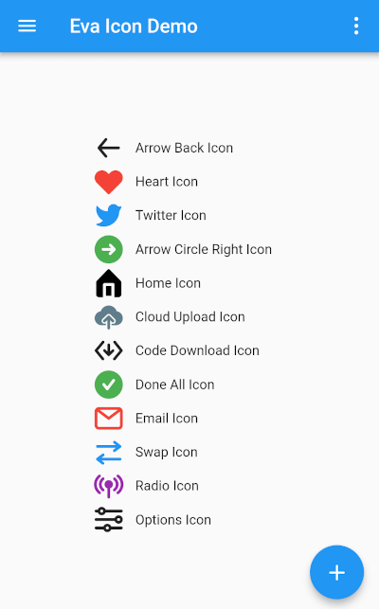
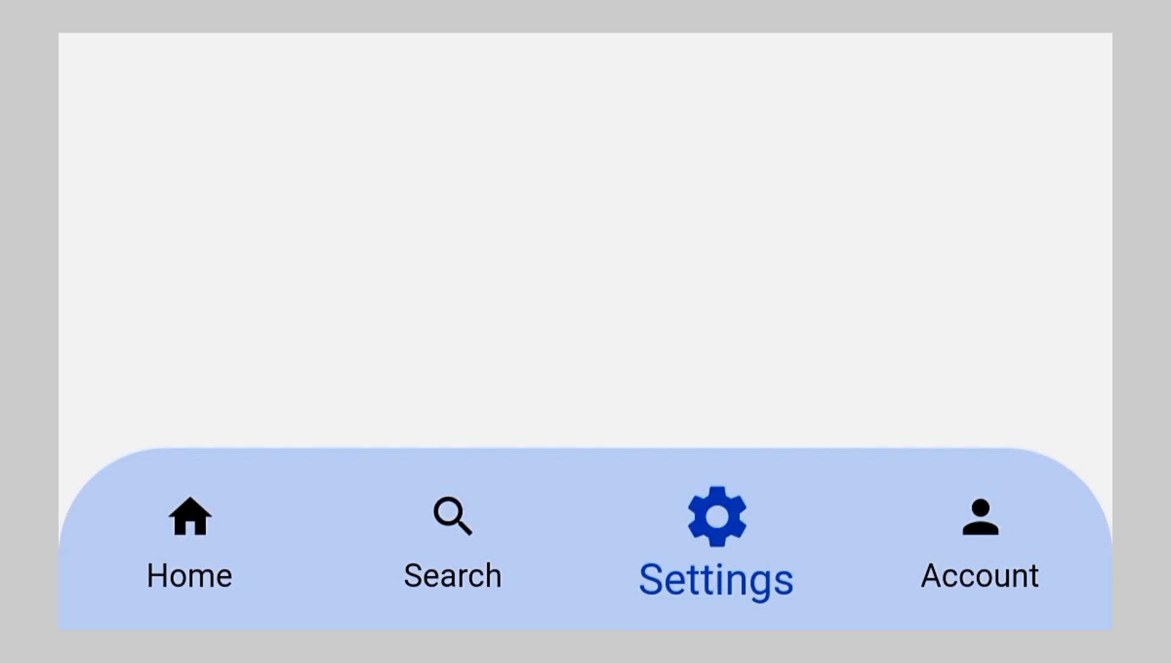
Icon Widgets

Slide 31
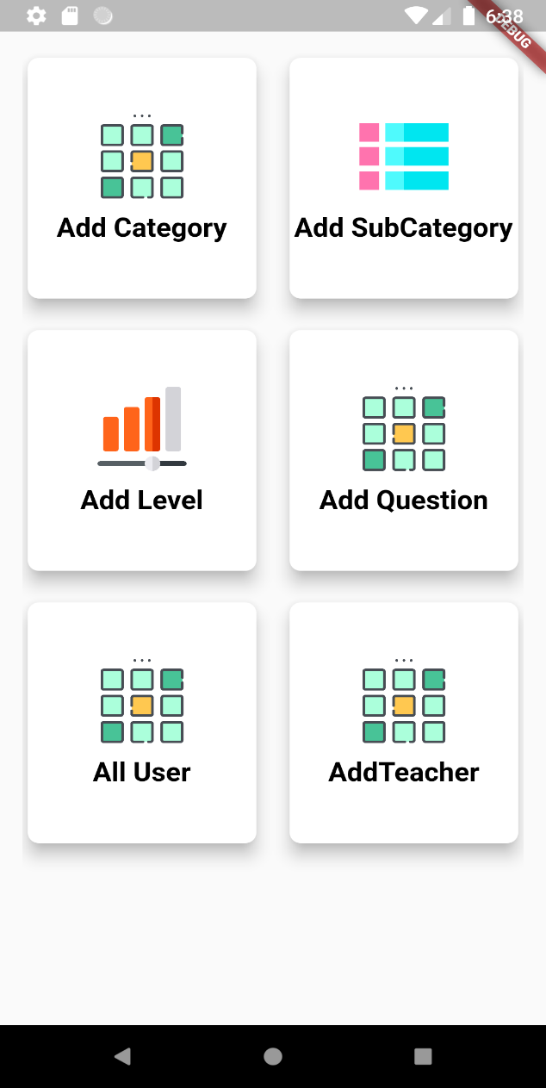
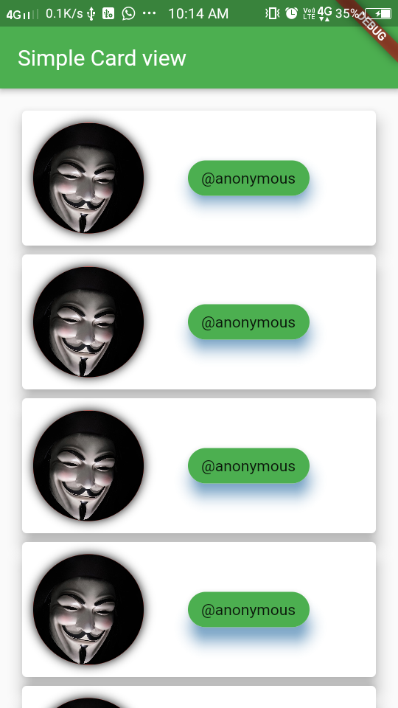
Card Widgets
Card is a widget that is used to create a rectangular area with four rounded corners and a shadow effect on its edges.

Slide 32
Card Widgets
Card widget properties:
  child: specifies the widget or content displayed within the card.
  color: Sets the background color of the card.
  elevation: Defines the shadow depth of the card.
  shadowColor: Sets the color of the card's shadow.
  shape: Defines the shape of the card e.g., RoundedRectangleBorder and ShapeBorder
  borderOnForeground: border shape is drawn in front of the card's children. The default is behind the children.
  margin: Sets the margin around the card widget.

Slide 33

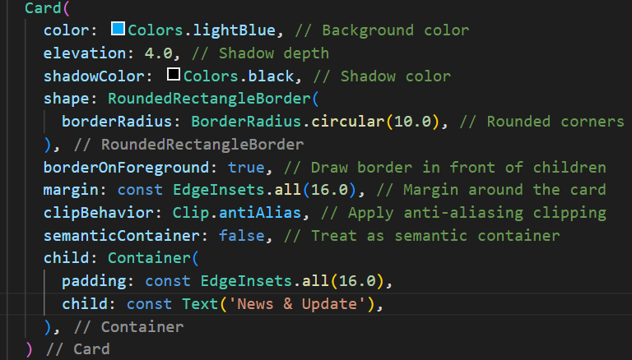
Card Widgets

Slide 34
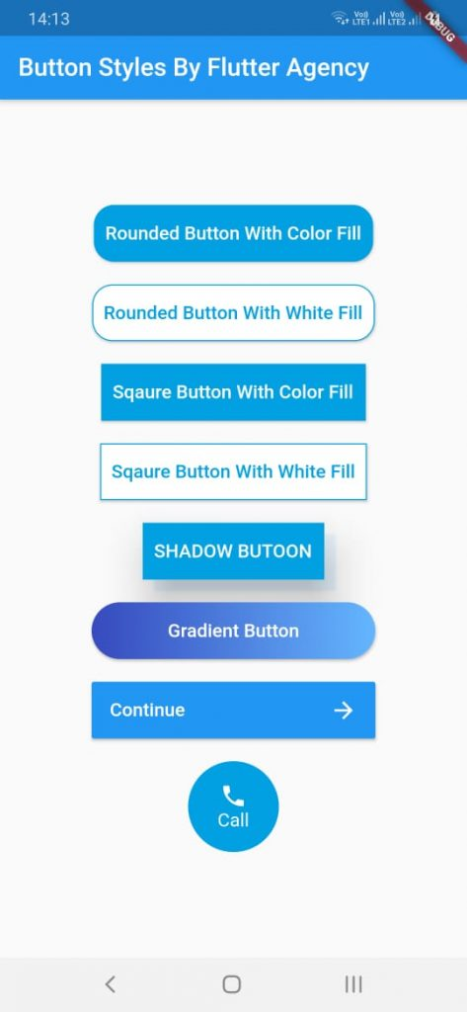
Button Widget
Button widgets in Flutter are used to create interactive elements that users can tap or click to trigger actions in the application.

Slide 35
Button Widget
  The common Button widgets are:
  ElevatedButton
  TextButton
  OutlinedButton
  IconButton
  Floating Action Button
  PopupMenu Button
  Drop Down Button
  ToggleButton

Slide 36
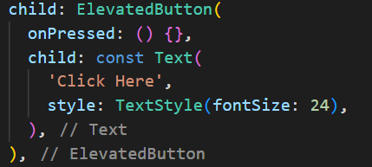

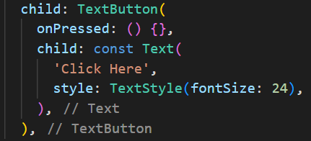

Button Widget
  ElevatedButton
  TextButton

Slide 37
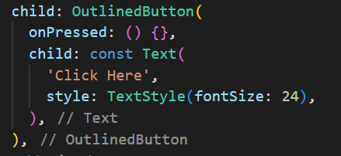

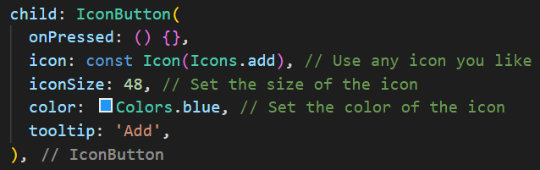

Button Widget
  OutlinedButton
  IconButton

Slide 38
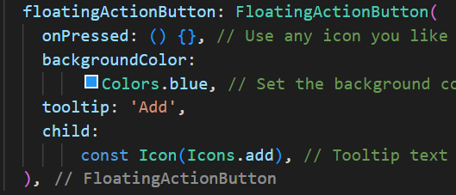

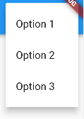

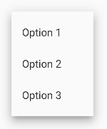
Button Widget
  Floating
  Action Button
  PopupMenu Button Dropdown Button

Slide 39
The Invisible Widget
Layout Widgets
  used to structure and arrange other widgets within the user interface.
  They help determine how widgets are positioned, sized, and aligned on the screen.
  The widgets:
    Container, Row, Column, Stack, ListView, GridView, Wrap, and Flexible and Expandible

Slide 40
How to Add Visible Widget to Layout Widget?
All layout widgets have either of the following:
  child - to take a single child e.g., Center or Container
  children – to take a list of widgets e.g., Row, Column, ListView, or Stack
const Center(
child: Text('Hello World'),
),

Slide 41
Container Widget
Container is a widget class that allows to customize its child widget.
It allows you to create a box with various properties such as padding, margin, color, border, and alignment.
Example:
  Text widget is placed in a Container to add margins
  Row widgets is placed in a Container to add padding around the row

Slide 42
Container Widget
Key properties:
  child: to include widget, e.g., Text or Image.
  alignment: specify values e.g., top-left, center, bottom-right, etc.
  padding: the space around the child widget
  margin: empty space around the Container
  color: background color of the Container.
  decoration: advanced decorations to the Container, e.g., gradients, borders, shadows, and images.
  width and height: the width and height of the Container.

Slide 43
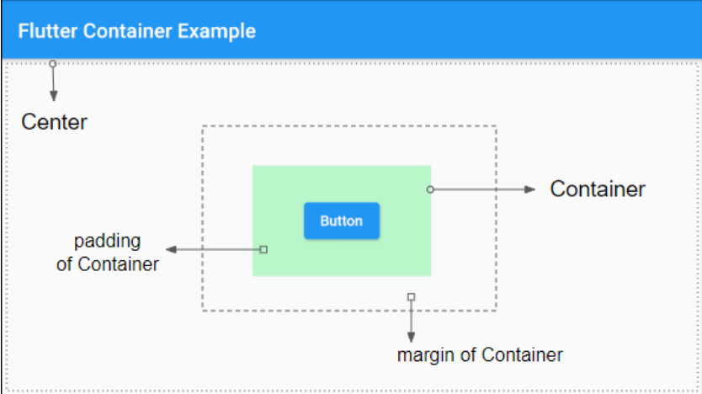
Container Widget

Slide 44
How to Add Multiple Widgets Vertically or Horizontally?
The most common layout patterns is to arrange widgets vertically or horizontally
We can use a Row widget to arrange widgets horizontally, and a Column widget to arrange widgets vertically.

Slide 45
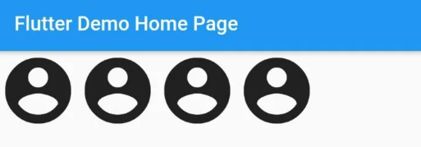
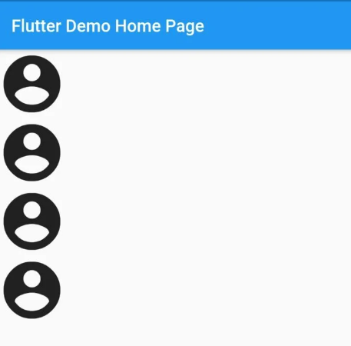
Row()
Row(
children:<Widget> [
Icon(Icons.account_circle,size: 80,),
Icon(Icons.account_circle,size: 80,),
Icon(Icons.account_circle,size: 80,),
Icon(Icons.account_circle,size: 80,),
],
),
Column()
Column(
children:<Widget> [
Icon(Icons.account_circle,size: 80,),
Icon(Icons.account_circle,size: 80,),
Icon(Icons.account_circle,size: 80,),
Icon(Icons.account_circle,size: 80,),
],
),

Slide 46
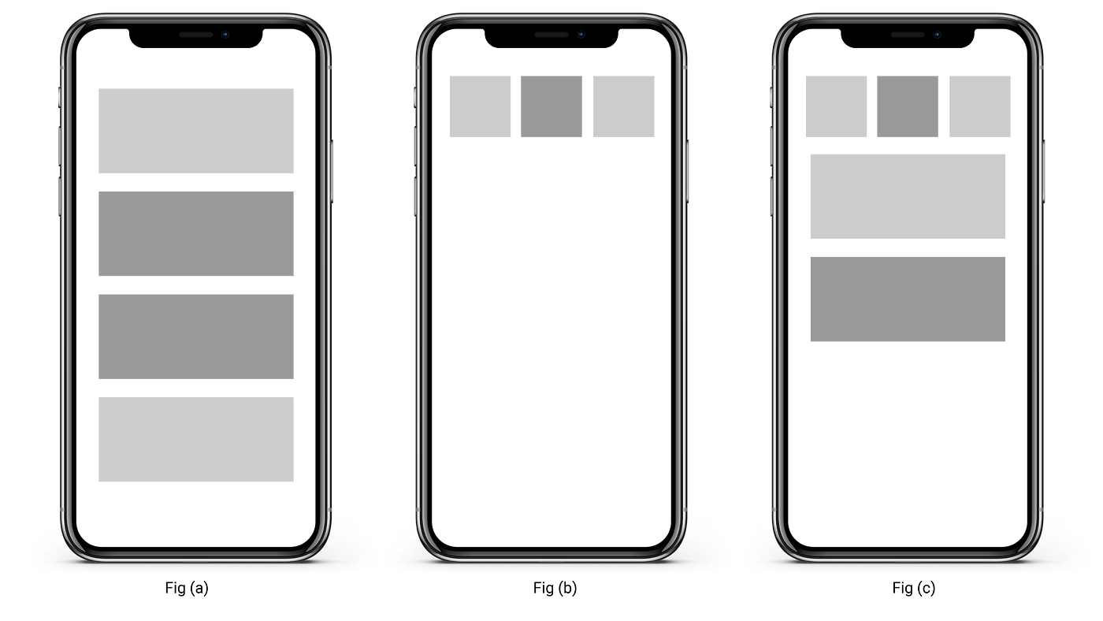
How to Add Multiple Widgets Vertically or Horizontally?
Row and Column each take a list of child widgets.
A child widget can itself be a Row, Column, or other complex widget.

Slide 47
Row Widget
The Row widget is used to arrange its children widgets in a horizontal line.
It allows multiple widgets is placed side by side within a parent container

Slide 48
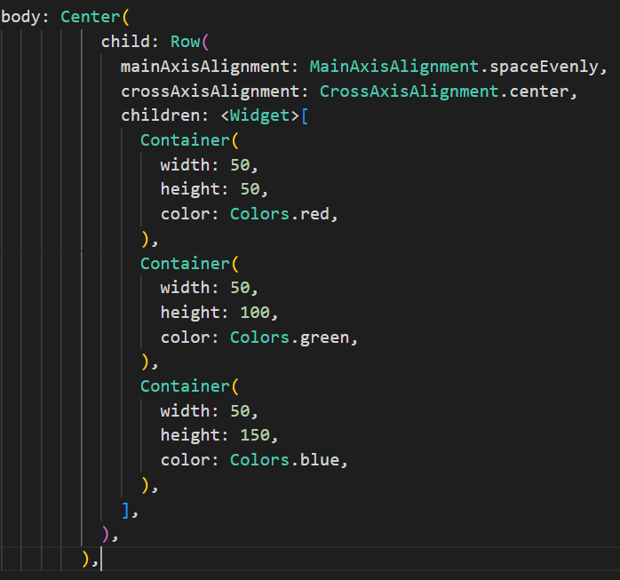
Row Widget

Slide 49
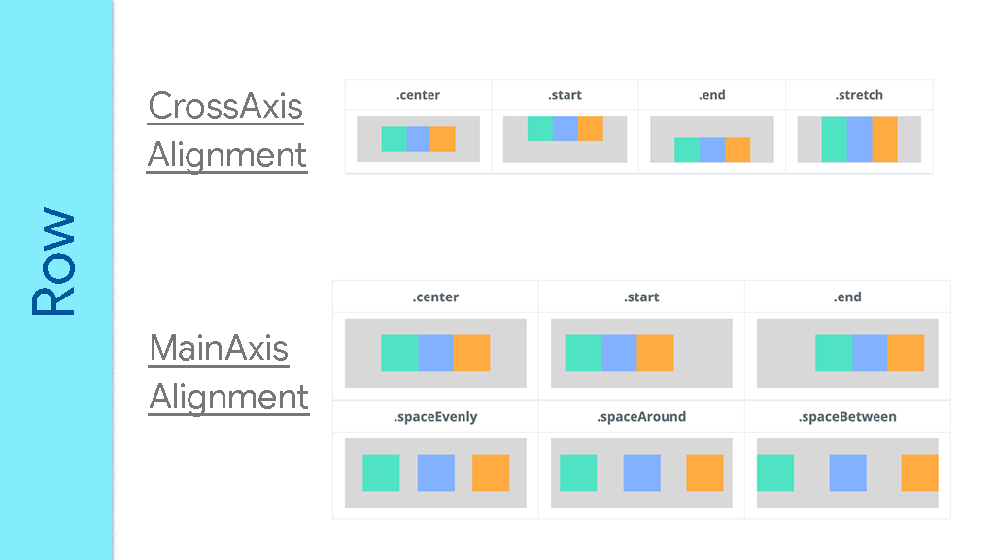
Row Widget

Slide 50
Column Widget
A Column is a widget in Flutter that displays its children one after another in the vertical direction.
If we want a child of the column to expand to the full height, we have to wrap it in an Expanded widget.
A column and row widgets cannot scroll – use listView instead.

Slide 51
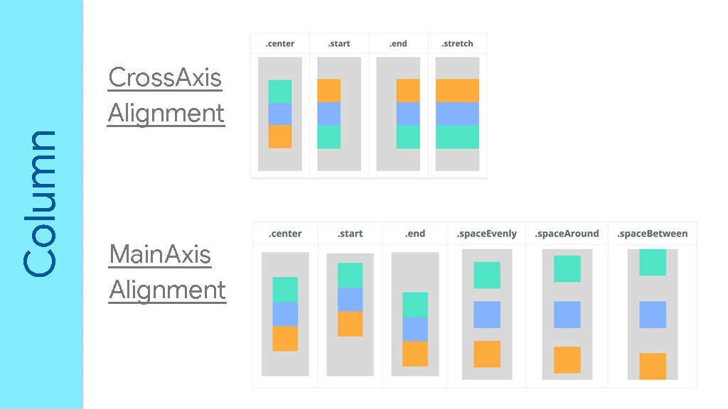
Column Widget

Slide 52
Stack Widget
The Stack widget - to overlay multiple widgets on top of each other.
It's a powerful layout widget to create complex UI designs by positioning widgets relative to each other within a stack.

Slide 53
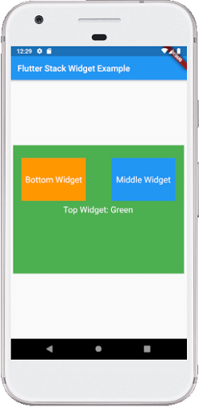
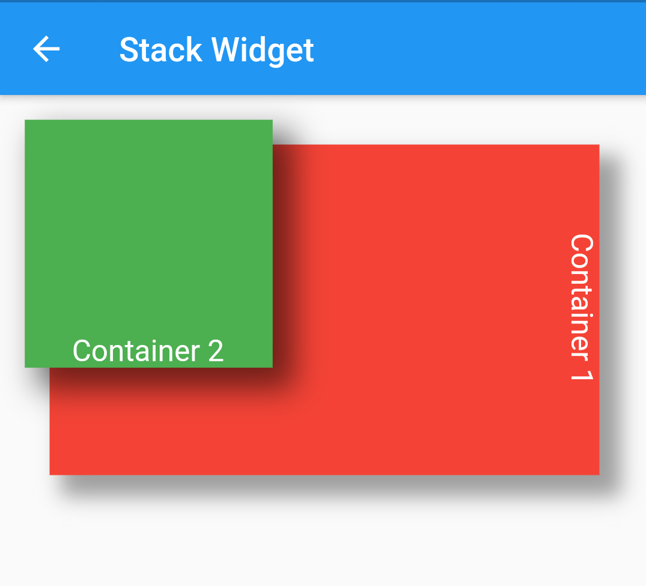
Stack Widget

Slide 54
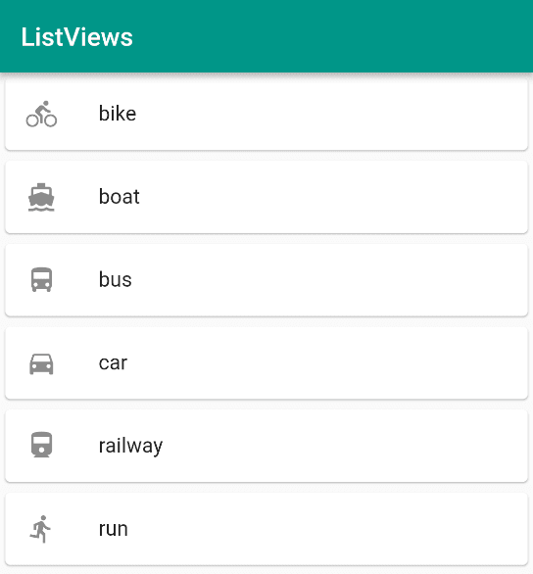
ListView Widget
The ListView widget is used to create a scrollable list of widgets in a single column.
It's one of the most commonly used widgets for displaying a large number of items in a vertical list format.

Slide 55
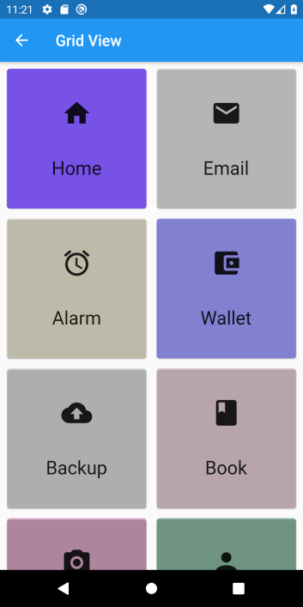
GridView Widget
The GridView widget - to display a scrollable grid of widgets in a two-dimensional layout.
It's an essential component for organizing data or widgets in a grid format, allowing users to scroll both horizontally and vertically to view all the items.

